Slide 1
VMware to OpenShift Migration - Single Click Migration
Demo

Slide 2
Agenda
Overview of migration process
Problem Statement
Migration Automation Architecture
Demo on Migration Execution Automation

Slide 3
Overview Of Migration Process
Pull the Data from TM / Runbook
Start the Sync
Initiate the Cutover
Create Migration Plan

Slide 4

Problem Statement: Solution:
Manual Migration Plans Creation
Manual Sync Start Activity
Manual Cutover Activity
Pre & Post Migration Checks
Human Errors
Time consumption & Efforts
Single click migration

Slide 5
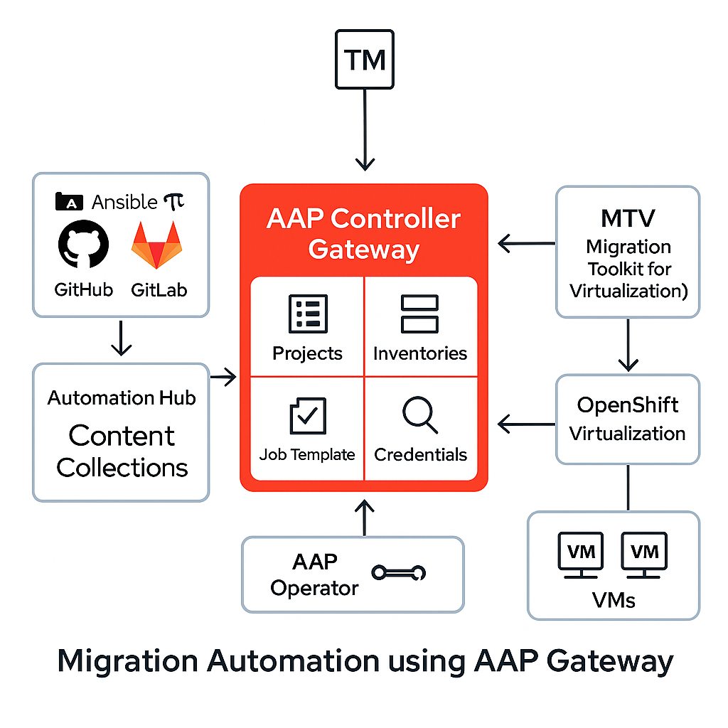
Migration Automation Architecture
Notes:
Keywords – AI, Automation, human errors avoidance Change this to SMART Goal Timelines Gratitude – Kiran, Anshul and Team

Slide 6
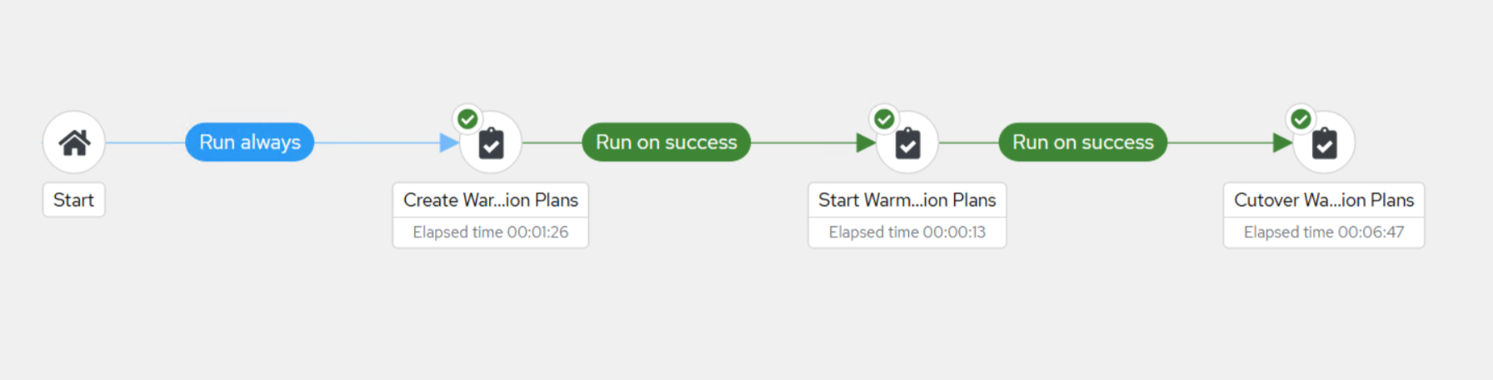
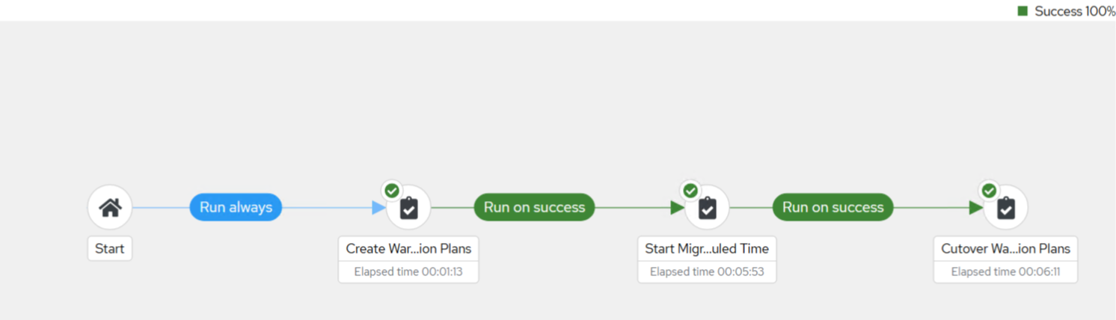
Migration Pipeline
Create WARM migration plans, Start sync, and Cutover
Pre -
checks
Post - checks
Create WARM migration plans, Start Sync by time, and Cutover
Pre -
checks
Post - checks

Slide 7
Demo

Slide 8




Features | OpenShift Migrator | Other Tool
Single Click Migration
AI Enabled Migration (In progress)
TM API integration (In progress)
Cold Migrations
Warm Migrations
Pre & Post migration checks

Slide 9
What Next?...!
Frontend UI
Integrate with AGENTIC AI
Notifications – Teams & Email
User can select the Migration event
Archive and Delete migration plans

Slide 10
Thank You

Slide 11

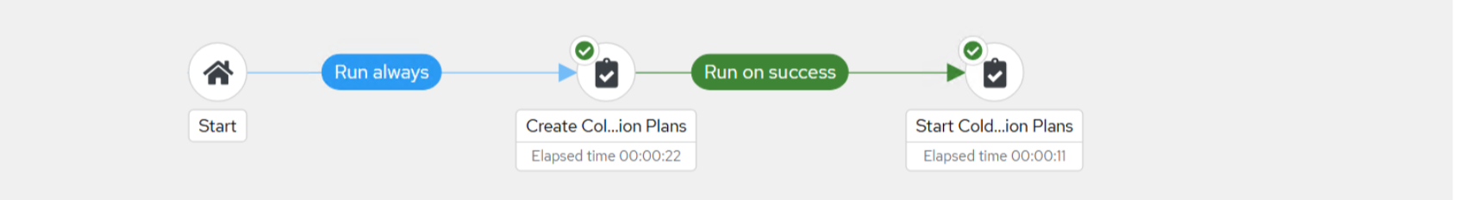
Migration Pipeline
Create WARM migration plans and Start sync by time
Create COLD migration plans and Cutover

